Slide 1

Business Research Methods
Module 1:
The Research Process

Slide 2
TODAY’S AGENDA
DESCRIBE THE MEANING OF EVIDENCE-BASED PRACTICE
UNFOLDING THE RESEARCH PROCESS
AN ANALOGY OF THE RESEARCH PROCESS
SOFT INTRODUCTION TO AN IMPORTANT METRIC CALLED THE CORRELATION COEFFICIENT

Slide 3

WHAT IS EVIDENCE-BASED PRACTICE?

Slide 4
Evidence-based practice
Origins = medical field
Dr. David Sackett (2006) defined it as “the conscientious, explicit and judicious use of current best evidence in making decisions about the care of individual patients.”
Sure – evidence exists! So, what else would doctors use to ply their trade?

Slide 5
Evidence-based practice
“Indeed, we would argue, managers are actually much more ignorant than doctors about which prescriptions are reliable – and they’re less eager to find out. If doctors practiced medicine like many companies practice management, there would be more unnecessarily sick or dead patients and many more doctors in jail or suffering other penalties for malpractice…
It’s time to start an evidence-based movement in the ranks of managers.”
Pfeffer & Sutton (2006; HBR)

Slide 6
Evidence-based practice

Slide 7
Evidence-based practice management

Slide 8
Evidence-based practice management
Evidence-based management means translating principles based on best evidence into organizational practices.

Slide 9
Evidence-based practice management
Evidence-based management means translating principles based on best evidence into organizational practices.
Let’s deconstruct this definition of EBMgmt…

Slide 10
Evidence-based practice management
Evidence-based management means translating principles based on best evidence into organizational practices.
Let’s deconstruct this definition of EBMgmt…
What is does it mean?

Slide 11
Evidence-based practice management
Evidence-based management means translating principles based on best evidence into organizational practices.
Let’s deconstruct this definition of EBMgmt…
What is does it mean?
What is inherent in the definition (e.g., does it make any assumptions?)

Slide 12

EBMgmt: Take away point
OUR DESTINATION

Slide 13
Unfolding the research process

Slide 14
Unfolding the research process
What You Do
Generate a Research Question
Consult Theory
Generate Hypothesis
Generate Prediction
Collect Data to Test Prediction
Analyze Data
Generalize Results

Slide 15
Unfolding the research process
What You Do
Generate a Research Question
Observe the World
Consult Theory
Can be based on data…
Does offering a free wristband increase the number of t-shirts sold at a concert?
Generate Hypothesis
Generate Prediction
Collect Data to Test Prediction
Can be anecdotal…
Does cell phone use cause brain tumors?
Analyze Data
Generalize Results

Slide 16
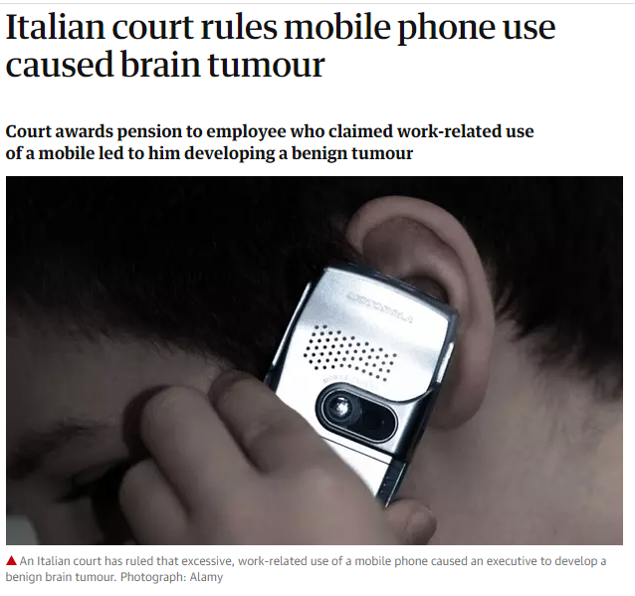
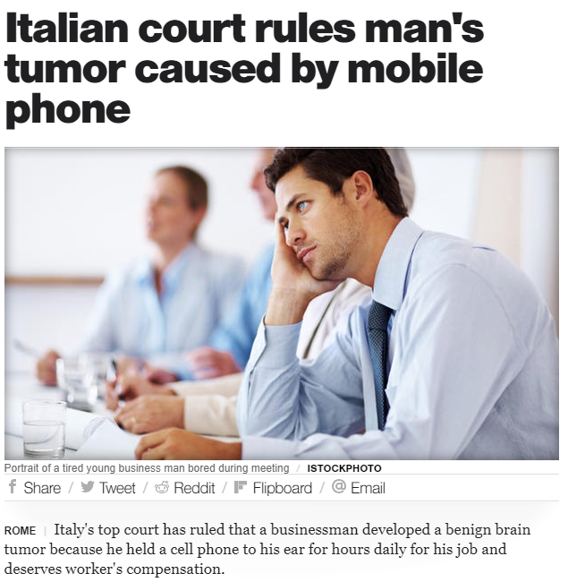
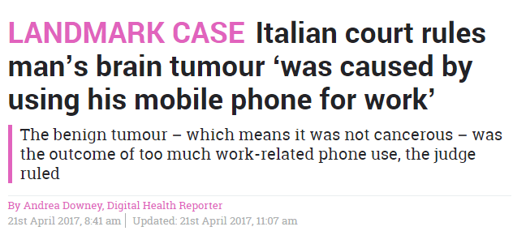
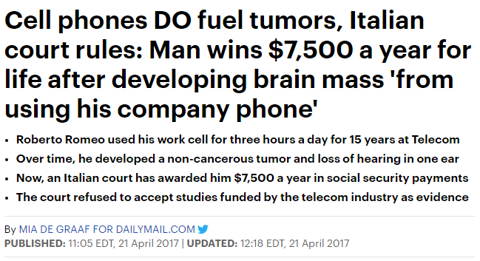

Slide 17
Unfolding the research process
What You Do
How You Do It
Generate a Research Question
Observe the World
Consult Theory
Generate Hypothesis
Generate Prediction
Collect Data to Test Prediction
Analyze Data
Generalize Results

Slide 18
Unfolding the research process
What You Do
How You Do It
Generate a Research Question
Observe the World
Consult Theory
A well-established principle to explain a broad range of observations
Generate Hypothesis
Generate Prediction
Collect Data to Test Prediction
Analyze Data
Generalize Results

Slide 19
Unfolding the research process
What You Do
How You Do It
Generate a Research Question
Observe the World
Consult Theory
A well-established principle to explain a broad range of observations
Generate Hypothesis
Proposed explanation of the specific observation
Generate Prediction
Collect Data to Test Prediction
Analyze Data
Generalize Results

Slide 20
Unfolding the research process
What You Do
How You Do It
Generate a Research Question
Observe the World
Consult Theory
A well-established principle to explain a broad range of observations
Generate Hypothesis
Proposed explanation of the specific observation
Generate Prediction
A hypo can be tested by operationalizing it as a prediction (scientific statement)
Collect Data to Test Prediction
Analyze Data
Generalize Results

Slide 21
Unfolding the research process
What You Do
How You Do It
Generate a Research Question
Observe the World
Consult Theory
A well-established principle to explain a broad range of observations
Generate Hypothesis
Proposed explanation of the specific observation
Generate Prediction
A hypo can be tested by operationalizing it as a prediction (scientific statement)
Collect Data to Test Prediction
Sample → Statistics → Parameter
Analyze Data
Generalize Results

Slide 22
Unfolding the research process
What You Do
How You Do It
Generate a Research Question
Observe the World
Consult Theory
A well-established principle to explain a broad range of observations
Generate Hypothesis
Proposed explanation of the specific observation
Generate Prediction
A hypo can be tested by operationalizing it as a prediction (scientific statement)
Collect Data to Test Prediction
Sample → Statistics → Parameter
Analyze Data
Descriptive stats vs. inferential stats
Generalize Results

Slide 23
Unfolding the research process
What You Do
How You Do It
Generate a Research Question
Observe the World
Consult Theory
A well-established principle to explain a broad range of observations
Generate Hypothesis
Proposed explanation of the specific observation
Generate Prediction
A hypo can be tested by operationalizing it as a prediction (scientific statement)
Collect Data to Test Prediction
Sample → Statistics → Parameter
Analyze Data
Descriptive stats vs. inferential stats
Generalize Results
Apply research question across different domains, times, etc.

Slide 24
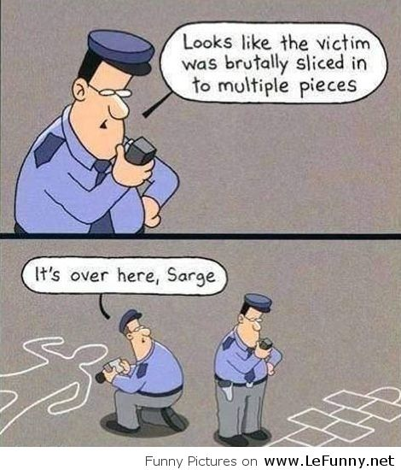
Crime in the classroom: An analogy

Slide 25
Crime in the classroom: An analogy
Before we begin, we have a very importance decision to make…

Slide 26


Crime in the classroom: An analogy

Slide 27

Crime in the classroom: An analogy

Slide 28

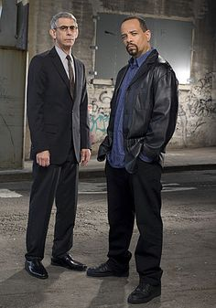

Crime in the classroom: An analogy
What will these characters do to solve the crime?

Slide 29
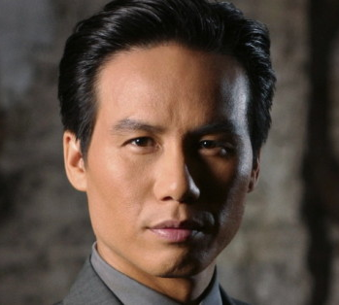

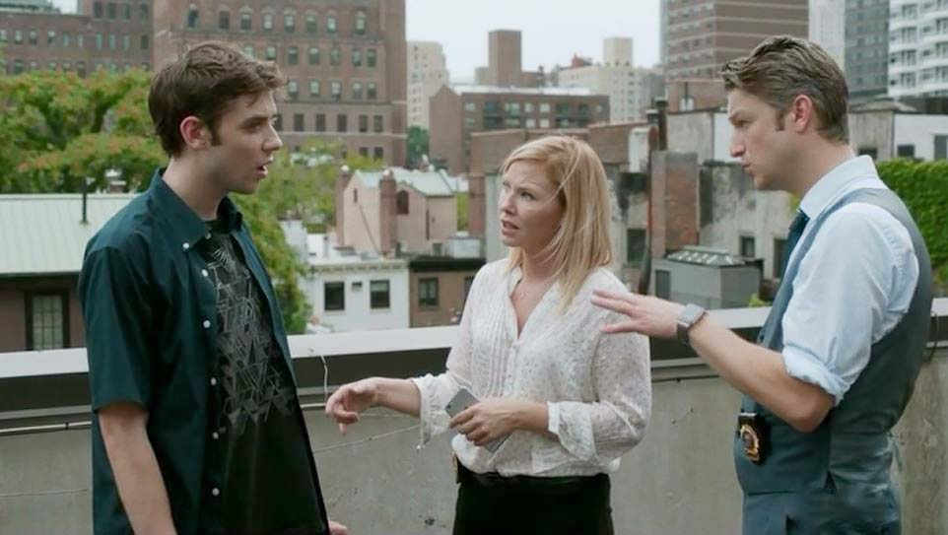
Crime in the classroom: An analogy
What types of evidence might be available?
Is some evidence more trustworthy than others? Why?
What do you consider to be the best/most ideal type of evidence?

Slide 30


Crime in the classroom: An analogy
During the trial, lawyers prosecute (present evidence) and defend (use other evidence) to persuade jury
The jury decides if the plaintiff is guilty or not guilty

Slide 31
Crime in the classroom: An analogy
In sum…
Are there different types of evidence?
Is some evidence better than others?
Why is some evidence better than others?

Slide 32
Crime in the classroom: An analogy
In sum…
Are there different types of evidence?
Is some evidence better than others?
Why is some evidence better than others?
TRUSTWORTHY EVIDENCE IS IMPORTANT

Slide 33
Crime in the classroom: An analogy
Research articles published in scientific journals are (usually) a great source of trustworthy evidence

Slide 34
Crime in the classroom: An analogy
Research articles published in scientific journals are (usually) a great source of trustworthy evidence

Slide 35
Crime in the classroom: An analogy
Research articles published in scientific journals are (usually) a great source of trustworthy evidence
However, a phenomenon referred to as the science-practice gap exists

Slide 36


Crime in the classroom: An analogy
Research articles published in scientific journals are (usually) a great source of trustworthy evidence
However, a phenomenon referred to as the science-practice gap exists
Science
Practice

Slide 37
Why understanding research is important
Helps us to better understand what’s “really” going on
Helps guide decision and action

Slide 38
Why understanding research is important
Helps us to better understand what’s “really” going on
Helps guide decision and action
A soft introduction to the effect size will help you better understand HRM research
Luckily, we must understand only two dimensions to interpret an effect size
Magnitude
[ranges from 0 to 1]
Direction
[positive or negative]
+

Slide 39
A motivating example
What you see now…
(Averages)
What you’re missing…
(Relationships: an additional “lens”)
Pay-for-performance
Climate
Training & development
.65
.02
.46
Job Satisfaction
Q: What actions should HR
pursue to improve loyalty?
A: Not sure… let’s try this…
Q: What actions should MGT
pursue to improve JobSat?
A: Focus on improving SS and
PA, in order of importance.

Slide 40
Another motivating example
Oil Change Frequency
Air Filter Change Freq.
Fuel Octane Used
.46
.02
.04
Engine Life

Slide 41
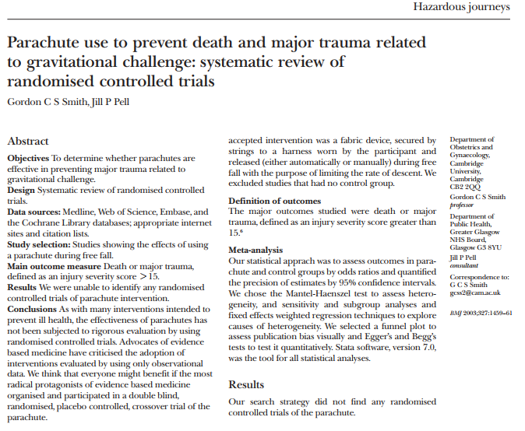
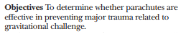
The Diverse World of Research

Slide 42
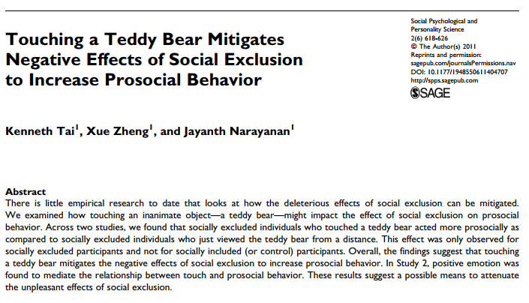
The Diverse World of Research

Slide 43
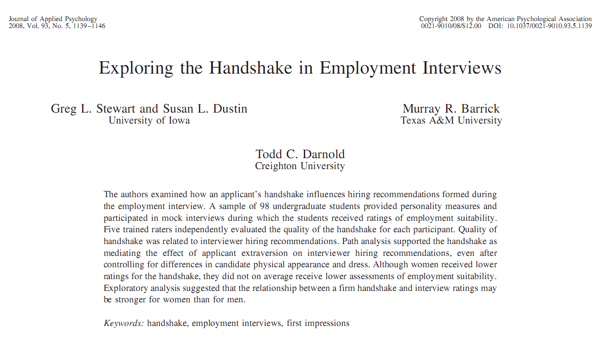
The Diverse World of Research

Slide 44
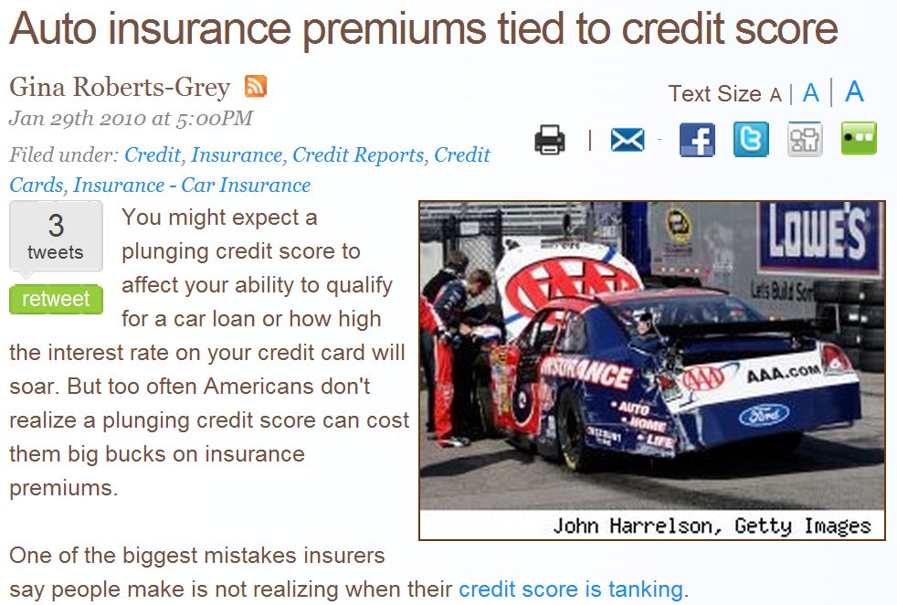
Understanding the effect size
A real life example

Slide 45
Understanding the effect size

Slide 46
Understanding the effect size
The jerk who almost hit me!!

Slide 47
Understanding the effect size

Slide 48
Understanding the effect size

Slide 49
Understanding the effect size
As credit score ↑
Turn signal usage ↑
= POSITIVE

Slide 50
Understanding the effect size
As credit score ↑
Turn signal usage ↑
= POSITIVE
It would be nice to assign a number to the data to describe the STRENGTH of the relationship

Slide 51
Understanding the effect size
Imagine that you are an actuary for an auto insurance company…
Assume that you can only choose one of the two above (ceteris paribus conditions)
Also assume that good turn signal habits are associated with fewer car crashes
Which of these two “predictors” (credit score or educational level) would recommend your insurance company use?

Slide 52
Understanding the effect size
Now which would you choose?
Herein lies the value of statistics. The ‘r’ is the correlation value.
(note: you can’t always “see” the difference, as you might above)

Slide 53
Understanding the effect size
Which is the stronger correlation?
.34
-.83

Slide 54
Understanding the effect size
Which is the stronger correlation?
.02
-.02

Slide 55
Understanding the effect size
What is a strong or weak correlation?
“Rule of thumb”
.00 → .18 = weak
.18 → .39 = moderate
.39 → 1.00 = strong
Note: Values above are absolute values, |r|.

Slide 56
Understanding the effect size
TABLE 1. "REGULAR" CORRELATION MATRIX
Variable | M | SD | 1 | 2 | 3 | 4 | 5 | 6 | 7 | 8 | 9 | 10 | 11 | 12 | 13 | 14
1. Supplier innovation | 5.05 | 0.75 | -
2. Supplier innovation knowledge | 5.43 | 0.99 | .35** | (.83)
3. Customer innovation know. | 4.93 | 1.17 | .29** | .29** | (.85)
4. Embedded ties | 5.58 | 0.86 | .22** | .22** | .13 | (.72)
5. Relationship length | 12.28 | 12.36 | .03 | -.03 | -.04 | .00 | -
6. Relationship formalization | 4.28 | 1.49 | .04 | .17* | .01 | .11 | .02 | -
7. CRS investments | 2.96 | 0.97 | .15 | .09 | .15 | .25** | .09 | .03 | (.84)
8. Supplier financial performance | 4.73 | 1.38 | .23** | .16* | .11 | .33** | .12 | .02 | .14 | (.93)
9. Supplier strategic advantage | 5.27 | 1.20 | .32** | .21 ** | .20* | .27** | .06 | -.00 | .19* | .43** | (.81)
10. Customer dependence | 0.18 | 0.39 | .07 | .09 | -.01 | .01 | -0.1 | -.1 | .02 | .04 | .03 | -
11. Market turbulence | 4.30 | 1.18 | .20* | .20* | .27** | .09 | .04 | .15 | .13 | .11 | .00 | -.10 | (.83)
12. Technological turbulence | 4.50 | 1.16 | .15 | .14 | .14 | .05 | .02 | .19* | .11 | .02 | .11 | .04 | .40** | (.80)
13. Opportunism | 2.84 | 1.10 | -.24** | -.26** | -.25** | -.25** | .09 | .28** | -.04 | -.22** | -.31** | .07 | -.06 | .07 | (.78)
14. Knowledge redundancy | 2.94 | 1.26 | -.17* | -.09 | -.12 | -.14 | -.00 | .12 | .11 | -.02 | -.07 | -.10 | .09 | .06 | .07 | -

Slide 57
Now that you’re experts in the correlation coefficient, MANG should be easy, right?

Slide 58

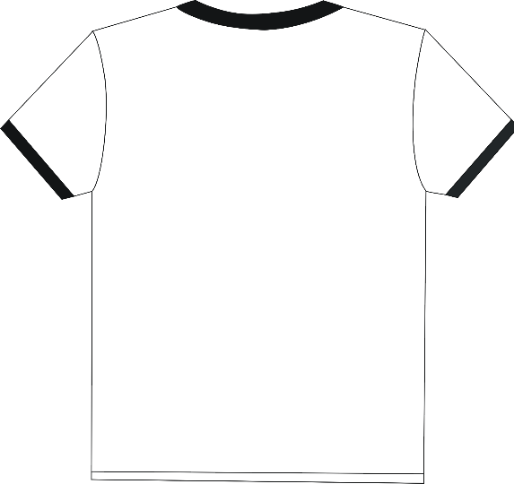
Now that you’re experts in the correlation coefficient, MANG should be easy, right?
MANG is hard

Slide 59

Now that you’re experts in the correlation coefficient, MANG should be easy, right?
MANG is hard

Slide 60
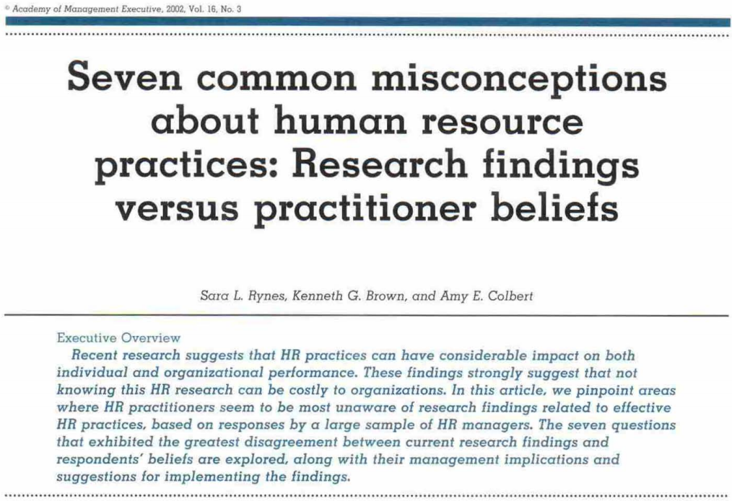
MANG 434 ISN’T EASY
Employees overestimate the importance of pay
Conscientiousness is a better predictor of job performance than intelligence
Integrity tests have adverse impact on racial minorities
Values > intelligence as a predictor of job performance
Integrity tests don’t work well
Decision making participation > setting performance goals
Performance appraisal errors can eliminated with training

Slide 61
Now that you’re experts in the correlation coefficient, MANG should be easy, right?
MANG is hard

Slide 62
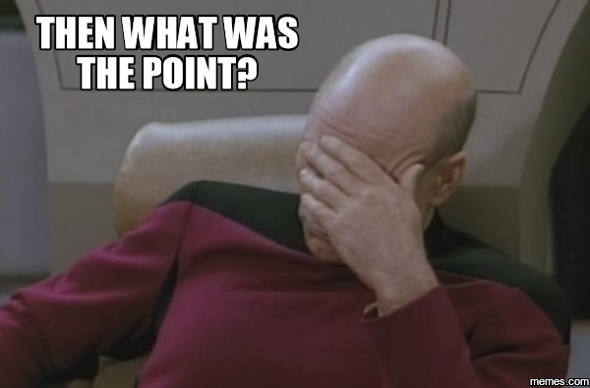
Now that you’re experts in the correlation coefficient, MANG should be easy, right?
MANG is hard

Slide 63
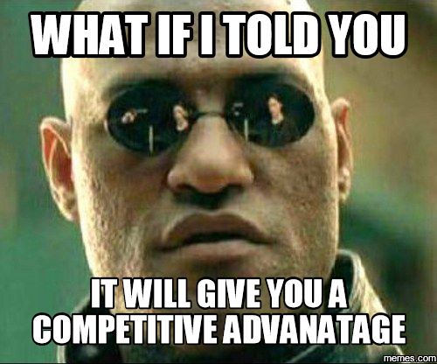
Now that you’re experts in the correlation coefficient, MANG should be easy, right?
MANG is hard

Slide 64
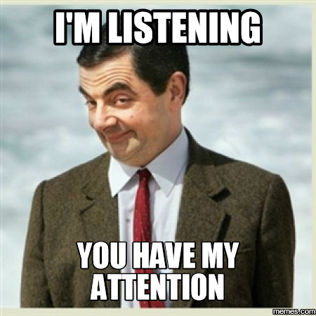
Now that you’re experts in the correlation coefficient, MANG should be easy, right?
MANG is hard

Slide 65

Now that you’re experts in the correlation coefficient, MANG should be easy, right?
MANG is hard

Slide 66
WELL, YOU JUST LEARNED HOW TO INTERPRET SCIENTIFIC FINDINGS

Slide 67
WELL, YOU JUST LEARNED HOW TO INTERPRET SCIENTIFIC FINDINGS
HY NOT USE SCIENTIFIC EVIDENCE TO INFORM YOUR HRM DECISIONS?

Slide 68
WELL, YOU JUST LEARNED HOW TO INTERPRET SCIENTIFIC FINDINGS
WHY NOT USE SCIENTIFIC EVIDENCE TO INFORM YOUR HRM DECISIONS?
THIS IS CALLED EVIDENCE-BASED PRACTICE

Slide 69
EVIDENCE-BASED PRACTICE
Science
Practice

Slide 70
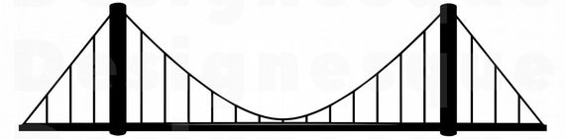
EVIDENCE-BASED PRACTICE
Science
Practice

